Slide 1
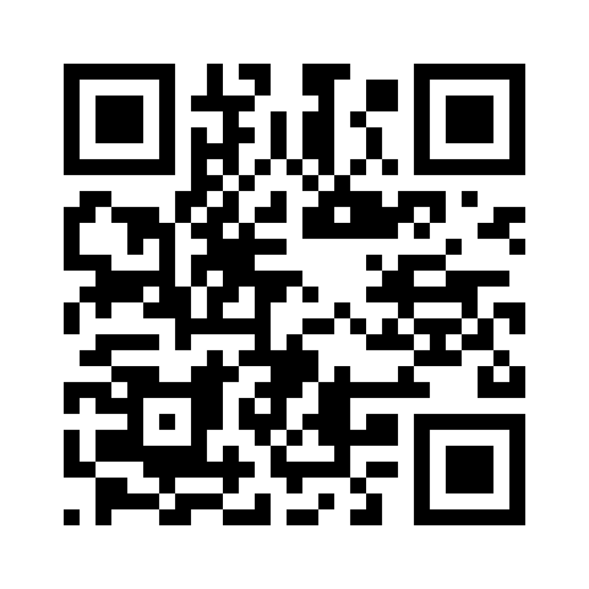
Download the App
Download the App
Download the App
Library Name
Library Name
Library Name

Slide 2
Download the app using the
QR code or visit:
www.yourlibraryalinkhere.com
Download the app using the
QR code or visit:
www.yourlibraryalinkhere.com
Download the app using the
QR code or visit:
www.yourlibraryalinkhere.com
Available now at your library
Available now at your library
Available now at your library
Reserve books online
Self-checkout
Search your library
Events and bookings
Library Information
Reserve books online
Self-checkout
Search your library
Events and bookings
Library Information
Reserve books online
Self-checkout
Search your library
Events and bookings
Library Information

