Slide 1
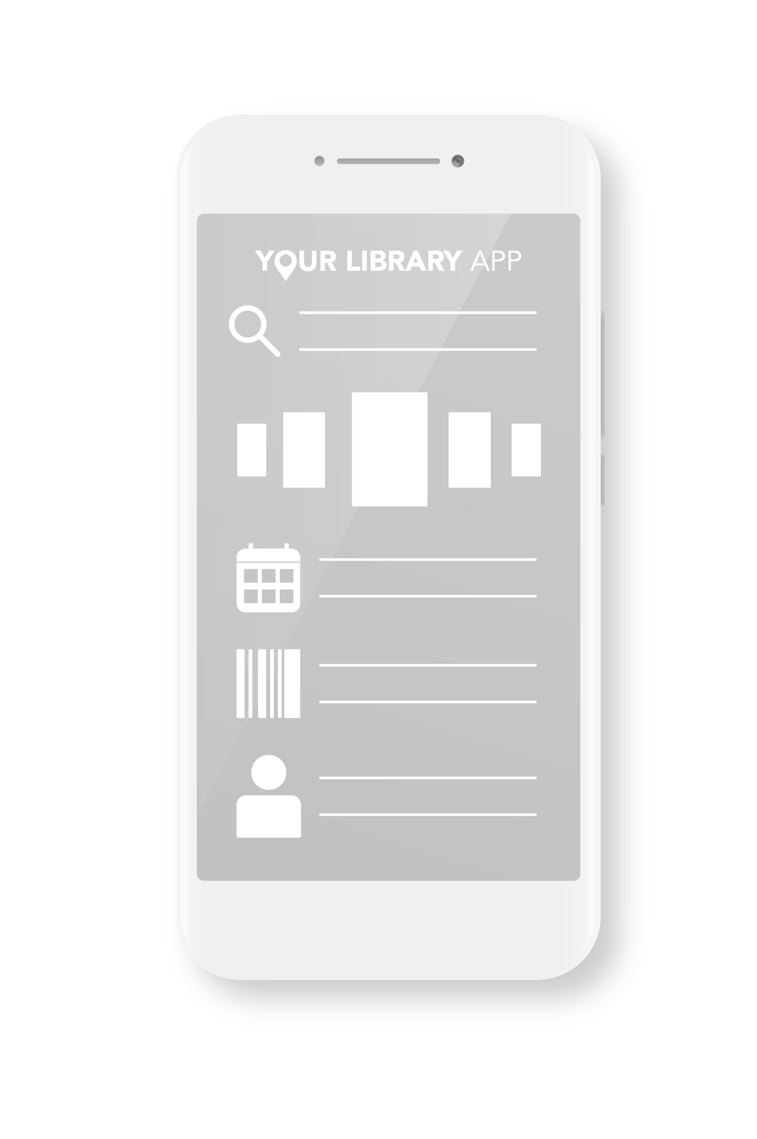
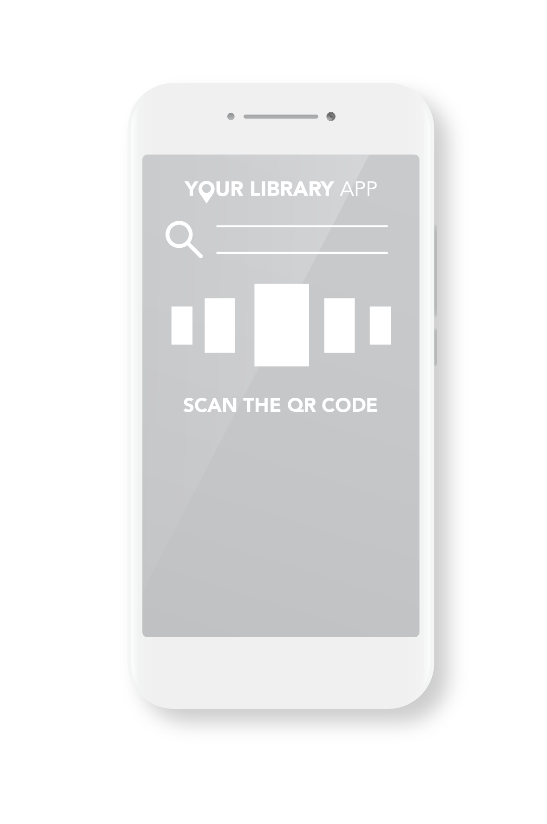
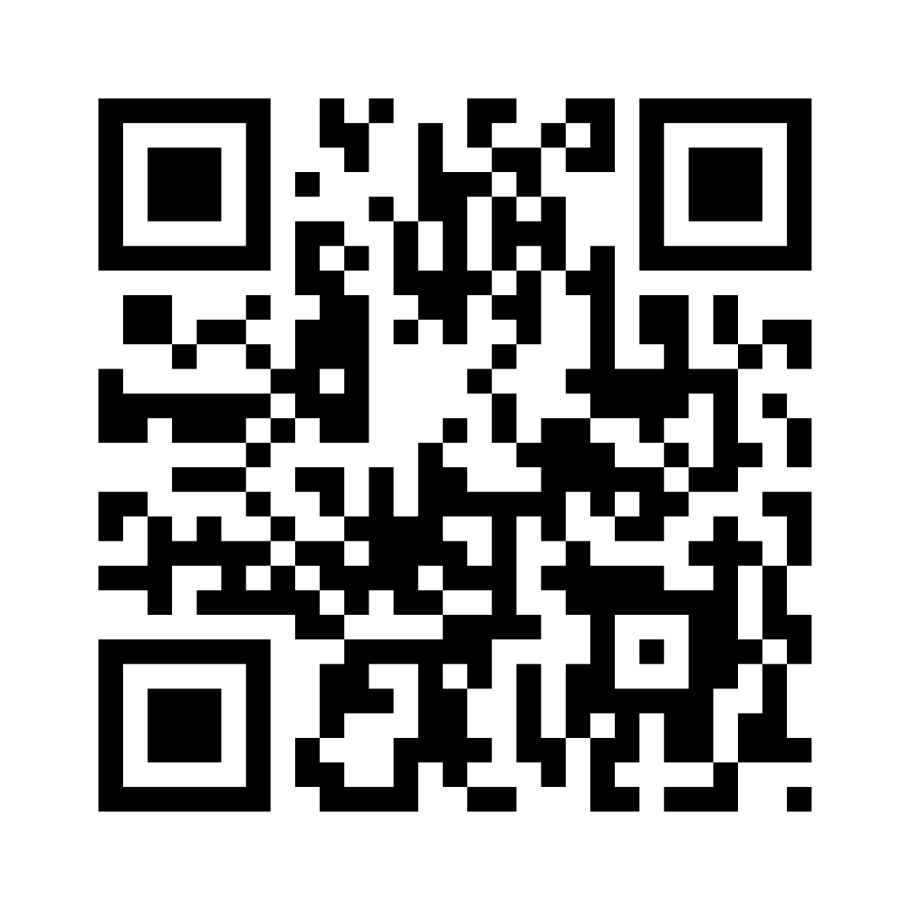
Library Name
Download Now
the library in your pocket
Reserve books online
Self-checkout
Search your library
Events and bookings
Library Information
www.yourlibraryapplinkgoeshere.com

